Slide 1
TOY MANAGEMENT APPLICATION

Slide 2
Current situation
_Store owner is strenuous on controlling current products and bills.
_Store owner has to hire at least two staff to run the store (If the store is big enough and has a large amount of products, the store owner needs to hire more to keep track of them. The larger your store is the more staff you have to hire).

Slide 3
.Hard to remember products: Our customer can not know how total of products that he is owning
.Waste time to calculate how much totally and write a bill by hand: When a customer comes to shop, and buys a lot. The staff has to calculate and write down the bill for them, sometimes the handwriting may be ugly. It will make the customer and the owner hard to read.
.Hard to store all of bills: Bills are made of paper, it not easy to preserve and store all the bills
.Mistake from staff: During work, mistakes more likely happen to the cashier, it can be wrong input for the price of the product.
If the store is big enough and has a large amount of products, the store owner needs to hire more to keep track of them. The larger your store is the more staff you have to hire. Mistakes may come from staff: Miss out products, report wrong product quantity to the store owner,...

Slide 4
Propose solution
Toy Management Application
Advantages of having TM Application:
_Help the store owner to manage bills, products and staffs.
_Help the cashier to create bill, check for product quantity and see all products that available in store.

Slide 5
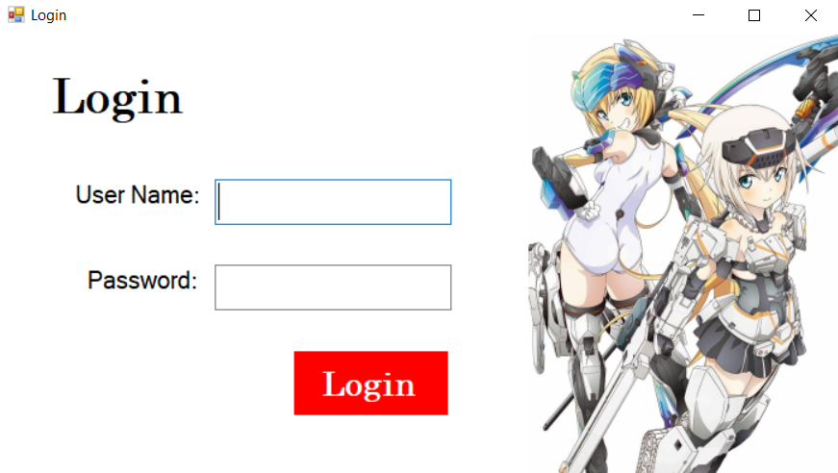
Our application has 2 main parts
1st part is about Admin’s functions
2nd part is about Staff’s functions

Slide 6
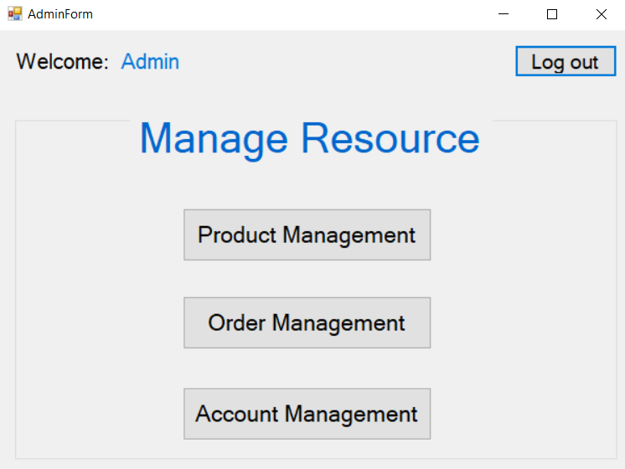
Admin’s functions
We have 3 main functions for Admin role:
Product Management: where we manage products of a store
Order Management: where we manage bills of a store
Account Management: where we manage accounts of this application

Slide 7
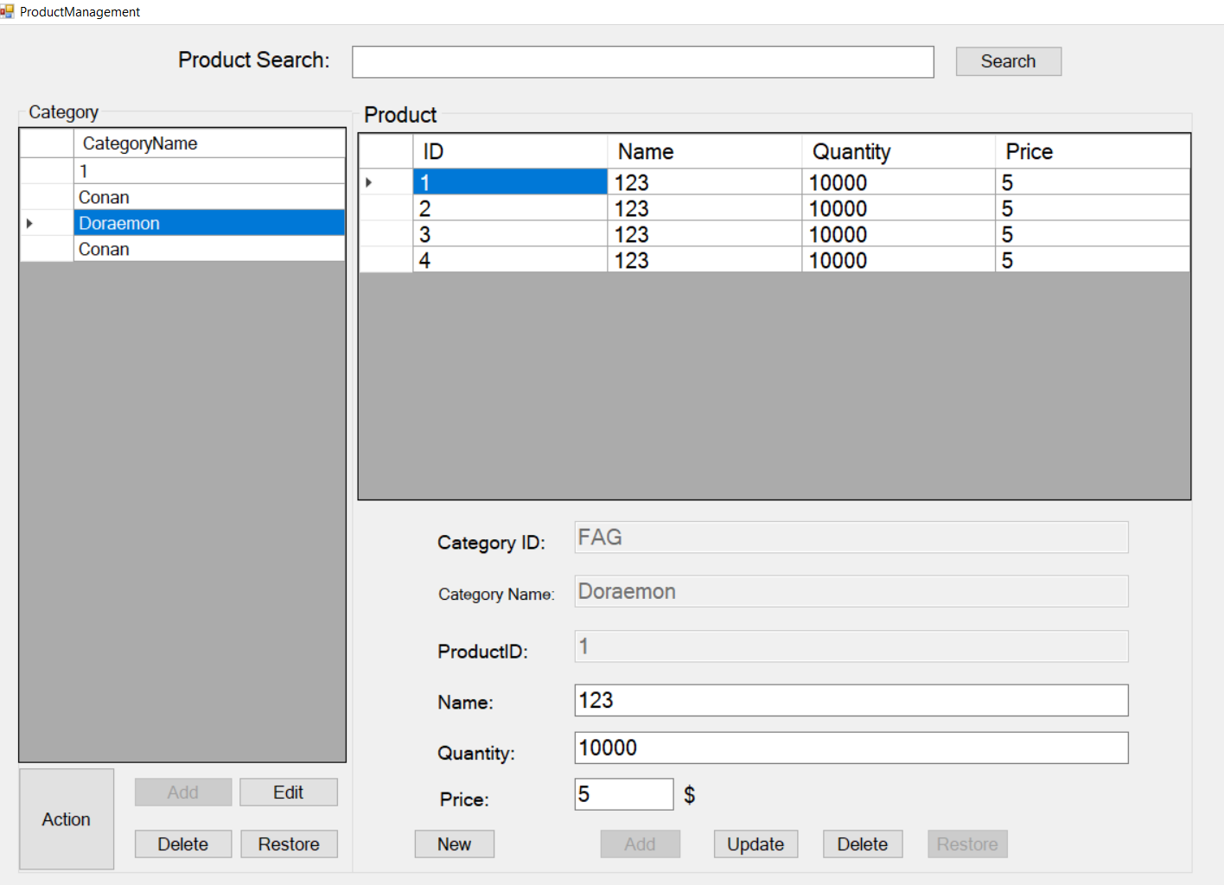
Product Management

Slide 8
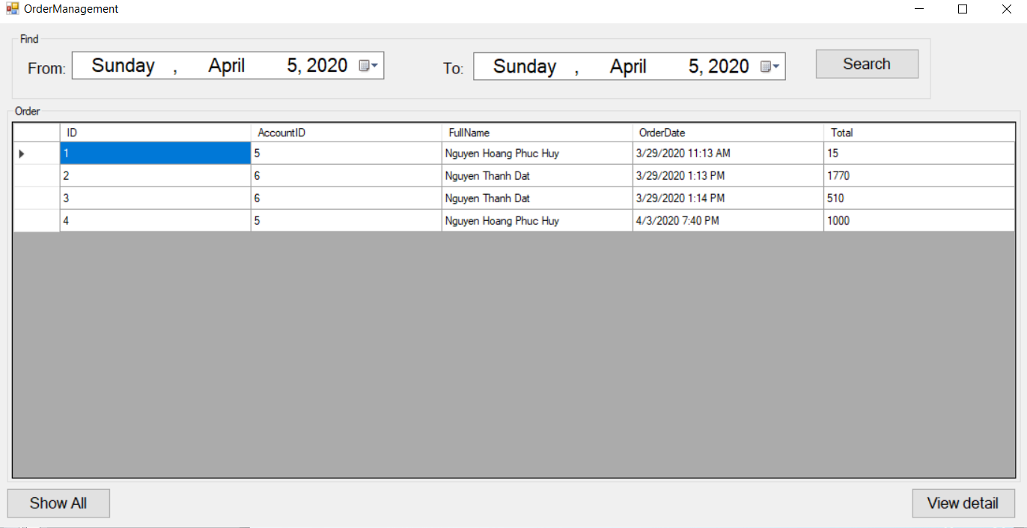
Order Management

Slide 9
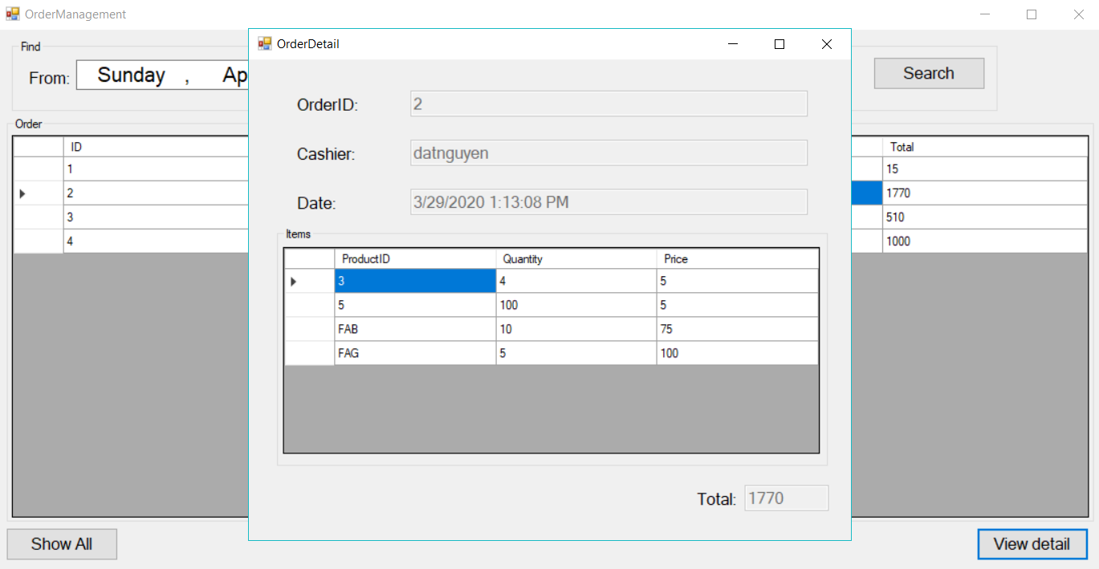
Order Management (cons)

Slide 10
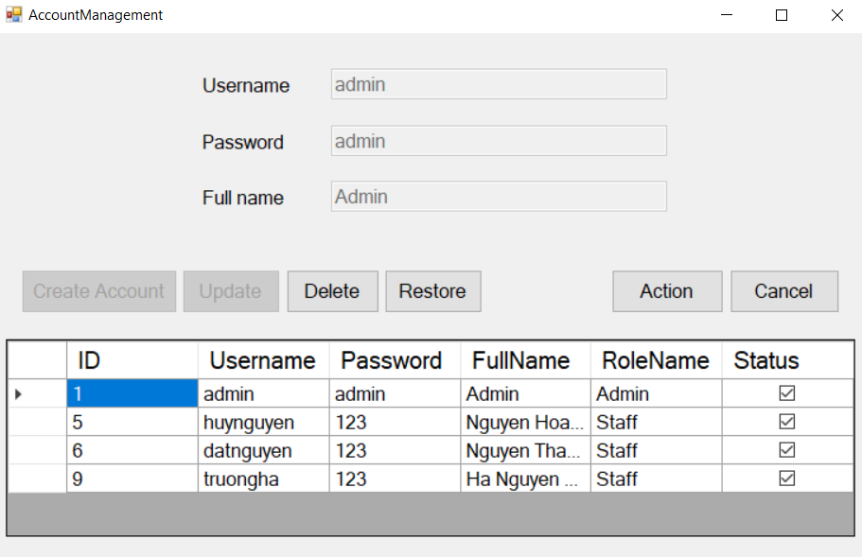
Account Management

Slide 11
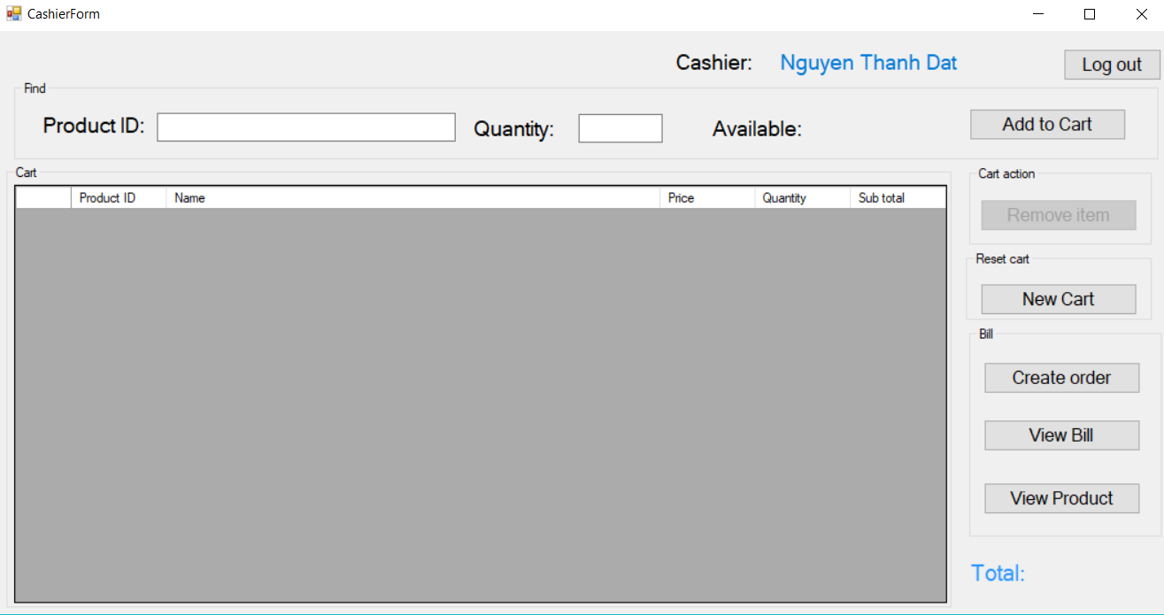
Staff’s functions
We have one main functions and 2 extra functions:
Cashier
View specific bills
View product

Slide 12
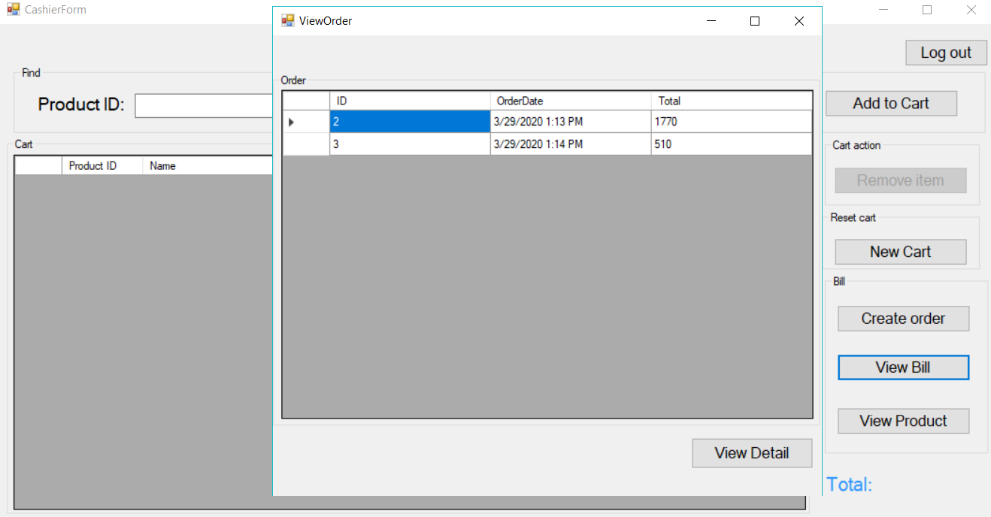
Extra functions

Slide 13
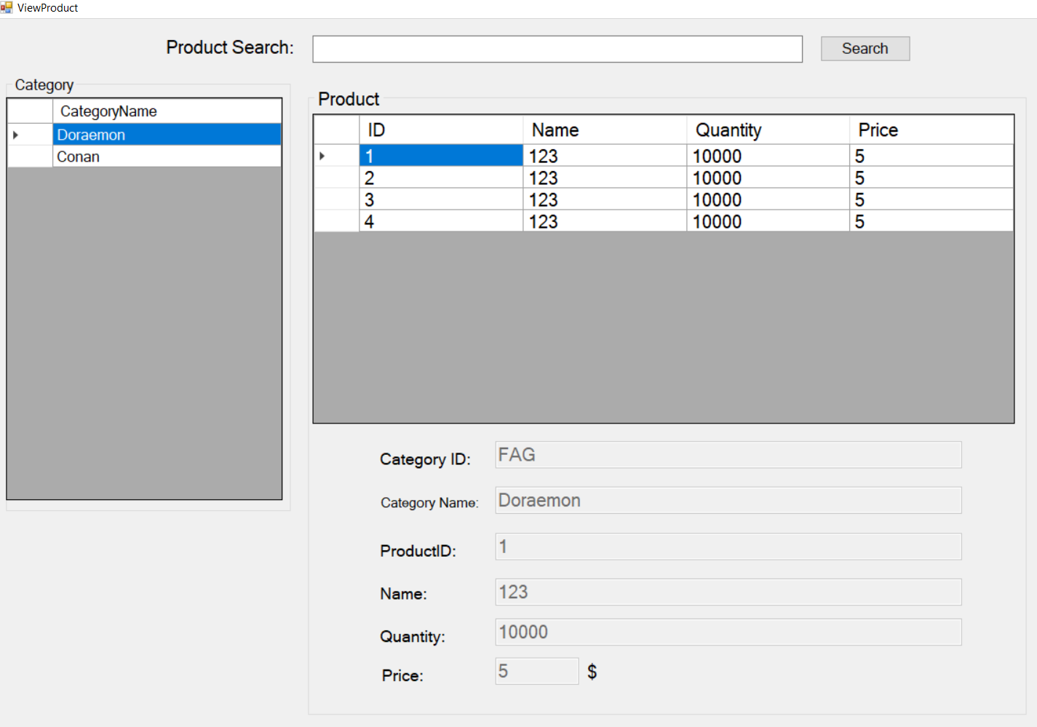
Extra functions (cons)

